Slide 1
Alresford Deanery
January 2024
Colin Harbidge Cathy Laird
Notes:
Purpose of tonight is to help everyone understand a bit more about diocesan finances and CMF.
This is an ongoing priority of us as we’re very aware that things are not always clear – and where there’s confusion, rumours often start which are usually entirely inaccurate but often more rememberable than reality!
To this end we have produced (for Synod in September last year) two very detailed budget documents for the next 3 years. These were overwhelming approved and we’ve shared with all PCCs and clergy and placed on our website for anyone and everyone to read.
They are quite long – but that’s because we’re dealing with complex issues, and a unique financial structure which takes time to explain.
https://winchester.anglican.org/governance/diocesan-synod/

Slide 2
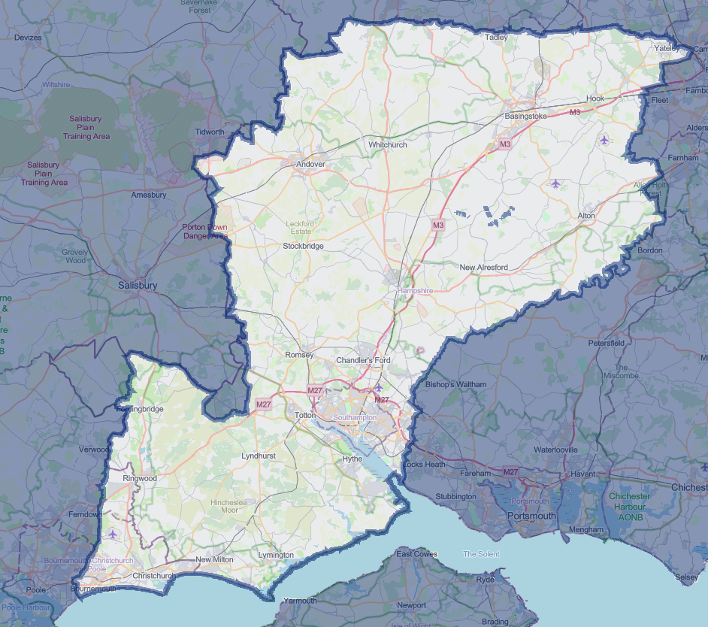
Understanding our Diocese
Population
1.25m
Notes:
Get to understand our diocese and finances through a quiz!
There is a map of our diocese on screen, from Basingstoke to Bournemouth, Southampton to Whitchurch, we cover most of Hampshire and parts of Dorset – BUT what is the approx. total population of our diocese?
Population: 1,250,000

Slide 3
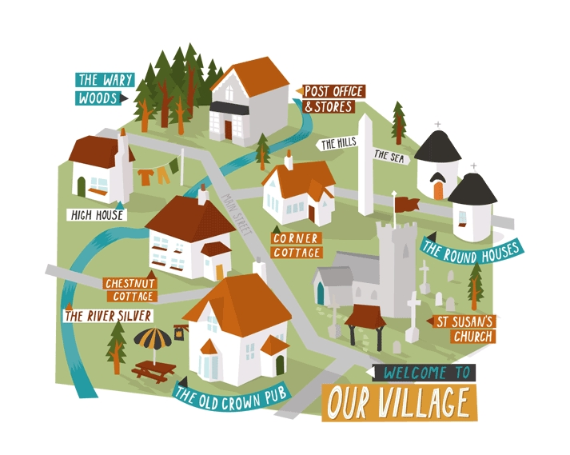



Parishes
250
Average Weekly Attendance
16,344
Authorised Ministers:
867
Church Buildings
367
Church Schools
100
Notes:
Moving on:
How many deaneries make up the Diocese) 13
What is the total average weekly attendance of the whole diocese: around 16,344
How many Church Buildings do we have in our diocese: Around 367
How many church schools do we have in our diocese: Around 100
How many authorised ministers (clergy, PT, LLMs, stipendiary or self supporting) do we have: 867
116.5fte stipendiary posts funded by the Diocese.
5.25fte stipendiary posts funded from national or parish level
28 stipendiary curates a year funded by the diocese.
5.5fte stipendiary curates funded by national grants.
22 House for Duty posts funded by the diocese
4 House for Duty posts funded by parishes.
56 Self-Supporting Ministers
258 clergy with Permission to Officiate
99 LLMs and LLWs
57 Authorised Preachers
474 people with the Bishop’s Commission for Mission (BCM)
6. How many parishes make up the diocese of Winchester: 255

Slide 4
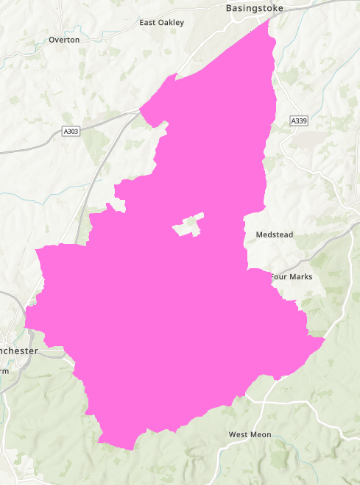

C
Notes:
Which Deanery is Alresford? C
Just like our parishes, each deanery is very different – in terms of size, priorities, population, number of church buildings, average deprivation and affluence etc.

Slide 5
Which Deanery has…
The smallest population?
Alresford 14,503
The largest population?
  Southampton 235,542
The highest ratio of stipendiary clergy to population?
Alresford 1:3,626
The lowest ratio of stipendiary clergy to population?
Southampton 1:16,356
The greatest % of its population attending church?
Alresford 2.9%
The lowest % of its population attending church?
Southampton 0.7%
Notes:
Which Deanery has the highest ratio of stipend. Clergy to population? Alresford 1:3,290
Which deanery has the lowest ratio of clergy to population? Southampton 1:13,866
Which deanery has the greatest % of its population attending church? Alresford 2.9% (about 420 people)
Which deanery has the lowest % of its population attending church? Southampton 0.7%
Danger of drawing too many conclusions from stats – but there’s possibly some correlation there… maybe.

Slide 6
Which Deanery has…
The most affluent population?
Alresford
The least affluent population?
Southampton
The highest average weekly giving levels?
Southampton £26.14
The lowest average weekly giving levels?
Whitchurch £12.57
Notes:
Which deanery has the most affluent population? Alresford (15.6)
Which deanery has the least affluent population? Southampton (7.55) Next lowest is Bournemouth on 10.46 – so there is substantial variation)
Which deanery has the highest average giving figures? Southampton £26.14
Which deanery has the lowest? Whitchurch (£12.57) (Alresford is 12th on £12.70)
Acknowledge that we are immensely grateful for all the giving from all our parishes. No judgement or criticism. Will be good reasons for these variations.
There is no set membership fee for being part of the CofE – people give according to their means, their commitments, priorities, teaching, and personal discipleship.

Slide 7
What is the (approximate) population of the largest parish in our Diocese?
26,400 | 30,900 |  | 44,900 | 53,700
What is the (approximate) population of the smallest parish in our Diocese?
105 |  | 84 | 39 | 23
Notes:
44,900 = Basingstoke Parish
39 = Morestead, outside Winchester
Need to be careful that when we talk about ‘parish’ we understand that not all parishes are the same!
One of the strap lines of the CofE is ‘A Christian Presence in every Community’. But what that presence looks like will need to be appropriate for the community in question.

Slide 8
Over the last 20 years, by what percentage has…
The usual Sunday Attendance across our diocese reduced?
40%
The number of stipendiary clergy reduced?
40%
The number of church buildings reduced?
2%
The number of individual parishes (PCCs) reduced?
8%
The average weekly giving per planned giver increased?
215%
Notes:
Average giving in 2003 versus now
£7.90 now £17.02. £9.12 increase over 20 years. That’s a 215% increase but represents an average increase of 46p per giver per year or less than 4p a month.
Total workforce and pool of members has reduced by about 40% in 20 years.
The burden of operations, compliance and governance has increased (SG, data protection, financial management, etc. ), population we serve has increased to 1.25m
BUT the number of individual parishes i.e. separate Charites has broadly remained static, and the number of church buildings has barely reduced.
That means we are asking a smaller group of people to do more every year. Meaning the percentage of our workforce that we are investing in administration and operations and governance rather than mission ministry and outreach is increasing every year.
Also important to note that attendance declined before clergy numbers. We only started reducing clergy numbers in this diocese in early 2000s, not because we wanted to save money, but because there weren’t enough clergy across the country. We even had a policy to replace stipendiary clergy with paid laity for many years.
So the narrative that is often shared that the church is declining because ‘big bad dioceses’ cut all the clergy for episcopal vanity projects isn’t actually correct. Decline was there for decades, and only after we ran out of people coming forward for ordination did we seriously start reducing posts.

Slide 9
What does this chart illustrate?
Notes:
What does this slide show??
This slide shows the average weekly giving stats for each of our 255 parishes….
From just over £4 a week to just under £90 a week.
We’re grateful for all giving across our diocese –we truly are. But there is a remarkable spread of what people give.
And it’s not (as we saw earlier) that the lowest giving is from our poorest communities. It’s the parishes that on paper are some of the most affluent where the giving levels are lowest.
There will be all sorts of reasons for this – and we must all be very careful not to judge, condemn or draw simplistic conclusions.
This slide for me doesn’t tell us any answers – but it does raise a lot of questions that we need to ask.
What would this look like in your deanery? £7.38 to £17.31 So even within this deanery there’s a £10 a week difference between average giving levels between your different parishes… I can’t tell you why that is – maybe something for your Deanery Synod to look into and understand? What are the blocks to giving? What are the reasons we don’t understand?

Slide 10
Across the 42 Dioceses, what is the average number of full-time equivalent employed staff in Diocesan Offices?
51.2 | 58.11 | 64.7 |  | 75.4
How many full-time equivalent employed staff are employed by Winchester?
51.2 | 58.11 | 64.7 | 75.4
Notes:
Across the country the average is 58.11
In Winchester, our average is 51.2.
We want to keep as much resource in our parishes as we can, but we have to be able to meet our statutory obligations and legal requirements.
Also worth noting that some of those posts are funded by external grant givers and therefore do not cost the parishes anything.

Slide 11
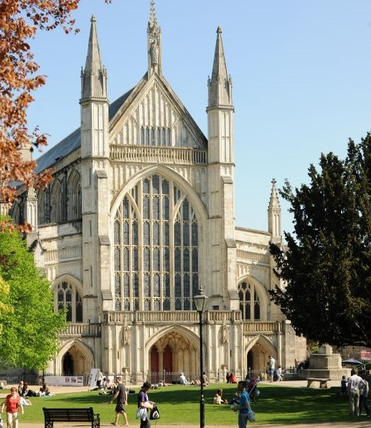
Which of the following statements is correct?
Winchester Cathedral has…
The widest tower in England
The largest stained glass window in Britain
The longest nave in Europe
Notes:
Longest nave

Slide 12

"to act in the public interest, serving all audiences through the provision of impartial, high-quality and distinctive output and services which inform, educate and entertain".
Notes:
BBC Radio
Hypothetical Question time now: Imagine some odd scenario whereby you can only ever listen to one of the 4 main BBC radio stations for the rest of your life… which would you choose? Hands up>
Why does the BBC have so many different channels and radio stations? Because their mission is to inform, educate and entertain ‘all audiences’. If you listen to Radio 4 news bulletin, and then radio 1 newsbeat – the facts are the same.
The Church of England is called to have a Christian presence in every community which we deliver primarily through our parishes. If all our churches provided only Radio 3 style worship, there would be huge parts of our society we would never connect with. Likewise, if all we ever offer is Radio 1, then there may be others who feel excluded.
This is where we talk about the mixed ecology of Church. The idea that we need different types of churches, styles of worship, and ways of reaching people and communities. For some it will be BCP choral evensong with full choir and robes… for others it will be an informal service of the word with modern worship songs, and for others still it will be something completely different from what most of us experience as ‘Church’ – meeting in café, prayer group in a school, outreach activity in an urban estate. They are all Church. They are all valid and they all serve a purpose.
Sadly, and it is genuinely sad, in recent years our Church has become more and more divided – rather than celebrating the fact that we are a broad and varied Church, with different traditions theological perspectives, styles of worship and expressions of ministry – it appears we are increasingly feeling threatened by the other radio stations – and want to condemn them. We create these false dichotomies – you’re either in favour of parishes or planting, you either priorities rural ministry or urban ministry, you’re either focused on pastoral ministry or pioneering ministry.
Notwithstanding that there are genuinely deeply held theological differences within our Church, too often our arguments are about style rather than substance, creating tribes and attacking each other.
That needs to stop.

Slide 13
Notes:
What percentage of Diocesan annual income comes from parishes (CMF and fees)?
78%, £9.1m a year.

Slide 14
Notes:
What percentage of Diocesan annual expenditure goes on local ministry and mission in our parishes and schools?
80%

Slide 15
Notes:
So 78% of our income comes from parishes
80% of our expenditure goes back to local ministry in parishes, churches and schools.

Slide 16
5 Main Income Streams for the Diocese of Winchester:
Common Mission Fund
Parochial Fees
Rental Income
Investment & Asset Income
Grants from external funders
Notes:
Which income stream is the most popular with parishes? Trick question, parishes object to them all!
Just to illustrate the challenges of diocesan life… we have 5 key income streams:
CMF
Fees
Rental Income
Asset Income
Grants
PCCs regularly tell us they can’t afford any more CMF. We listen and have reduced our request by £700k for this year.
GS has just agreed to run a pilot of not charging for wedding and funeral fees to see if that increases the number in our churches – if that becomes law, then we’d lose £400k pa of income.
Almost every PCC I know hates us renting out their house during vacancies as they fear it artificially extends the length of the vacancy. But it raises £1m a year.
Income from our investments has been positive but limited recently. In 2021 our BCSC agreed a programme of house sales that were no longer required (40 houses) to raise around £20m to invest. All income from the investments to be designated to only support costs of stipendiary clergy in parish ministry. Most parishes are very upset at this loss – we understand as they are more than just a house – they mean something to people on a deeply emotional level. But… we have to pay the bills.
Grants – last year we managed to receive £4.5m of grant funding from DIP to support strategic ministry investment projects across our diocese over the next 7 years. Some would go on revitalising parishes in Soton and Bournemouth. Some would go on extending and expanding our Growing Rural Parishes Programme. We can only get grants that align with the SMMIB’s objectives and criteria. Despite this positive news, many clergy and parishes were deeply upset that the funding didn’t appear to ‘value’ their particular ministries or contexts. I received lots of complaints as a result.
Risk of appearing slightly bitter but it highlights the challenge of serving our broad and diverse Church family. We all say we want more clergy, more investment in local ministry and mission across our parishes, schools and chaplaincies. We all want to see our congregations grow, and our impact in our communities increase. But very few people want to actually contribute to it, or even make any compromises that would allow us to find other sources of income.

Slide 17
 | 2027 | 2028 | 2029 | 2030
Income | 12,506 | 12,770 | 13,040 | 13,316
Expenditure | 12,886 | 13,326 | 13,782 | 14,254
Operating Surplus/(Deficit) | (380) | (556) | (742) | (938)
Notes:
And this is why it matters… this is why I and our Board of Directors must make unpopular decisions
Projections to 2030 if nothing changes (and assuming CMF is met in full).
This is not our future – but it is a warning.
If we ask you to think about changes, to try new things, to reconsider ways of working - this is why. Not because we want to destroy tradition, or upset communities, hate parish ministry, or don’t believe in the value of ordained ministry or any of the other conspiracy theories that fly around… But because we have these figures in our minds.
40% decline in attendance.
Aging church membership
£1m deficit by 2030 if nothing changes.
These aren’t my problems, or +Philips, or yours. They are problems for all of us.
But the good news is we have time. We know these are the risks and the challenges we need to face. And that gives us the chance, under Philip’s leadership and trusting in the Holy Spirit to find a new future – one of hope, humility, and joy.

Slide 18
Solve this anagram:
Cheerio infected sows
Diocese of Winchester
Notes:
So to finish before I hand over to you to get your own back and ask me questions, I’ll offer you one final bonus question.
Can you solve this anagram?

Slide 19


